Slide 1

Enabling Automation, Self Service Data & Smarter Analytics with The Intelligent Data Hub ™

Slide 2
Industry Challenges
Lines of Business
Siloed Data
Multiple Data Sources & Apps
External Data
Data & Analytics
Operational
Risk
Compliance & Regulation
Types of Data
Customer
Broker
Product
Location
Reference
Market Forces
Competition
New Products
M & A
Drive Automation
Self Service Approach
Better Analytics
Data Quality Issues
Lack of Governance
Limited 360 View
Resource Challenges
Reliance on IT
Business Deadlines
  …

Slide 3


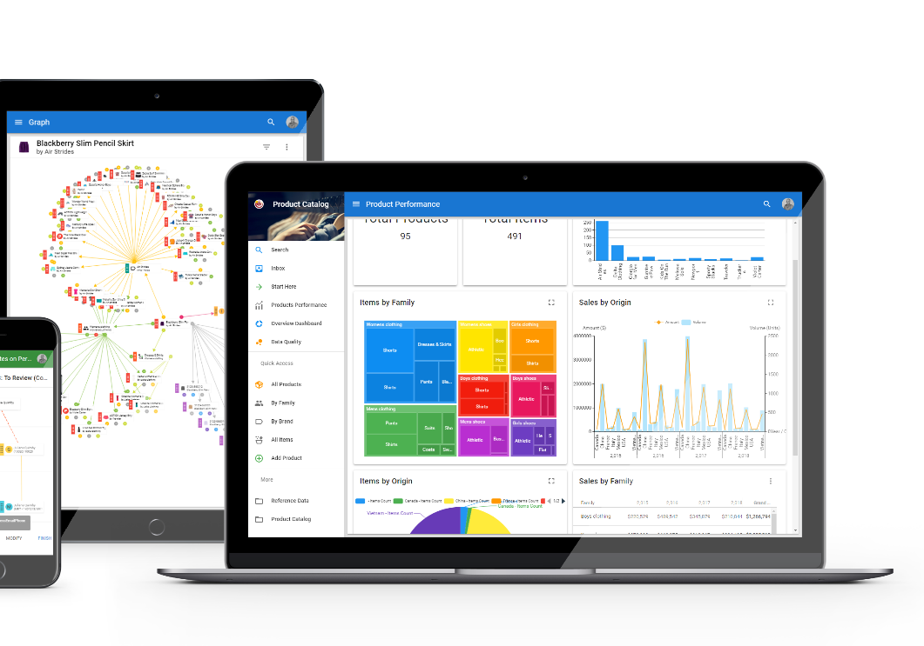
The Intelligent Data Hub™
DG
DQ
ETL / Data Prep
MDM
Data Catalogs
BI & Analytics, Big Data
AI/ML

Slide 4
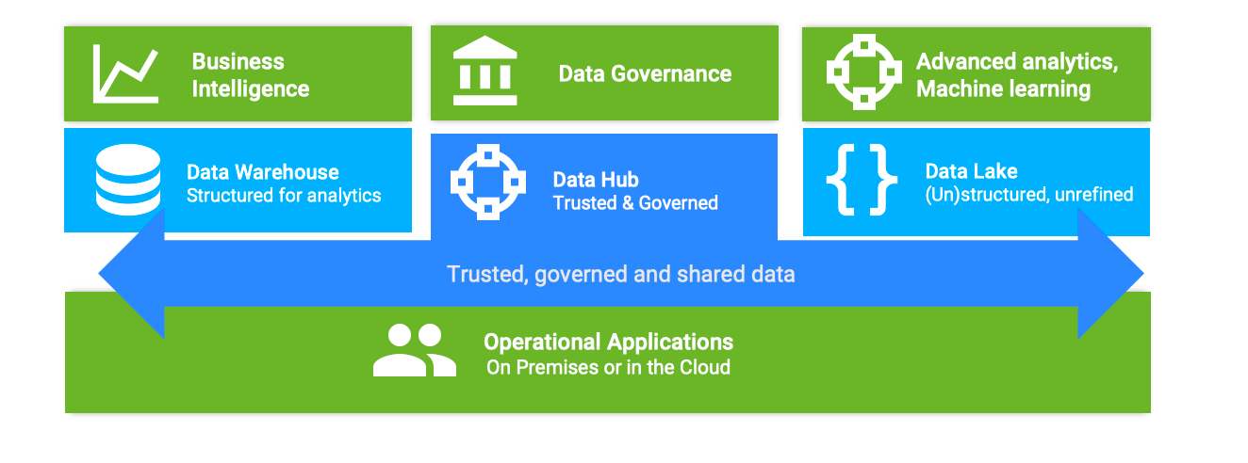
Supporting Data Automation & Smarter Analytics

Slide 5
















Multi Domain
Profiling
Data Apps
ERP
eCom
The Intelligent Data Hub™
brings together information that lives across applications such that it can be governed, mastered and managed in a centrally understood, non-disruptive way.
Data quality
Workflows
Intelligent Data Hub
CRM
Manage, Govern & Act
Support
Enrichment
Dashboards
Marketing
Parties
Things
SCM
Match / merge
Integration APIs
HR
Data Lake
Places
Ref. Data
Data providers
Microservices
Finance
Data
Warehouse

Slide 6

















































Trusted, Shared & Governed Data
Business
Operational Apps
(any of your apps)
Architects
Champions
Analytical Apps
(any of your apps)
MDM & Data Governance
Single portal for collaboration, definitions and compliance enforcement
Discovery
Source data profiling
Integration
Data flows and mappings
Enrichment
Smart algorithms, blending and classification
Quality
Data validation, matching and survivorship
Workflows
Guided authoring, collaboration and notifications
Metrics
KPIs and predictive analytics
Content Providers (extensible)

Slide 7


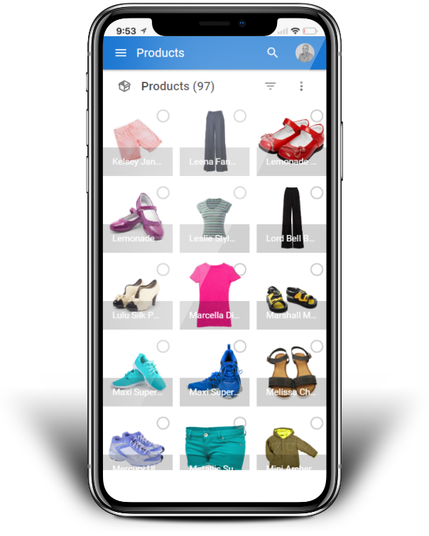


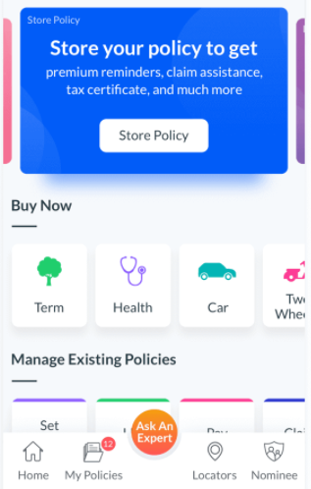






- Supports Self Service Approach
Democratized 360° view
Tailored design
Customer, Product, Reference, Location Data consolidated
Comprehensive data modeling & workflows
Collaborative governance
Any data source
Powerful UI for Business-curate to enforce regulatory policies
Real-time or batch integration through APIs
Built-in insights
Enterprise scale
Classify, browse, query, search, lineage
Highly secured & scalable architecture
Value-driven approach
Cloud or On-prem
Dashboards & KPIs to measure efficiency
AWS, Azure, Virtual Instances

Slide 8





The Intelligent Data Hub™ Company
Fast Growing
PSG investment, 2-digit annual growth
Proven
150+ clients, globally, strong market recognition
Visionary Platform
Agility, Simplicity & ROI at the core of our values
Powerful User Experience
Friendly and easy UI for Business Users

Slide 9






Benefits of The Intelligent Data Hub™
Customer Experience = Profit
Self Service Productivity
Regulatory Compliance
Optimised decision making
Increased upsell
X-channel sales opportunities
Better customer retention
Improved customer satisfaction
Centralised data reduced costs
Minimise regulatory risks
Ensure compliance with IFRS 17 standards
Reduce risk of fraud
Notes:
Smart:
Dynamic instantiation of the MDM from the logical model and governance rules (definition vs enforcement) …. Shortens the lifecycle between dev/prod
Self-learning dynamic classification & curation of data (match & merge, etc.) [intelligence for biz users, enabling data champions]
Prioritization of work queues and dynamic assignment of tasks (inbox & workflows)
Automated interactions [Chatbots, etc.]
Leveraging existing recognition APIs [e.g. Amazon porn recognition, MSFT AI-based facial recognition – as callable APIs/Plug-in]
Agile:
Declarative/rules-driven design [drastically shortens time to prod]
Role-based/Persona-based applications – designed once and deployed in multiple facets [Dynamic application morphs to role logged in]
Cloud/On-Prem – same software [fast time to value… move from cloud PoV integration to prod w/out loss]
Integrated *Collaborative* Governance – definition AND enforcement
Measurable:
Points made above for Smart & Agile contribute to xDM ability to get to a measurable point faster [ROI often hard to calc years later]
Faster adoption – as xDM is evolved into the business (vs. ‘big bang‘ implementation)
Extensible – expands via iterations without re-coding the base application [cust example – GrDF, BAE, DLR, Elesvier: one domain to many]
Metrics (Pulse): ability measure metrics and KPIs… [e.g. impact of duplicates, relation to staffing, measurable SLAs (i.e. onboarding)]

Slide 10



www.semarchy.com

